Slide 1

WELCOME
Mobile And Application Development

Slide 2

Notifications in Android
Mobile And Application Development
Practical
Instructor: Muhammad Naeem Khan

Slide 3
FrameLayout in Andriod
Android Framelayout is a ViewGroup subclass that is used to specify the position of multiple views placed on top of each other to represent a single view screen. Generally, we can say FrameLayout simply blocks a particular area on the screen to display a single view. Here, all the child views or elements are added in stack format means the most recently added child will be shown on the top of the screen. But, we can add multiple children’s views and control their positions only by using gravity attributes in FrameLayout.

Slide 4
FrameLayout in Andriod
The FrameLayout can be defined using the code below:
<FrameLayout xmlns:android="http://schemas.android.com/apk/res/android" android:layout_width="match_parent" android:layout_height="match_parent" android:orientation="vertical"> // Add items or widgets here </FrameLayout>

Slide 5
What is Notification?
It is a message you can display to the user outside of your application’s normal UI.
When you tell the system to issue a notification, it first appears as an icon in the notification area.
To see the details of the notification, the notification drawer.
It provides short, timely information about the action happened in the application, even it is not running.

Slide 6
What is Notification?
It provide the user with remainders, communication from other people, or other timely information from your app.
It display the icon, title and some amount of context text.

Slide 7
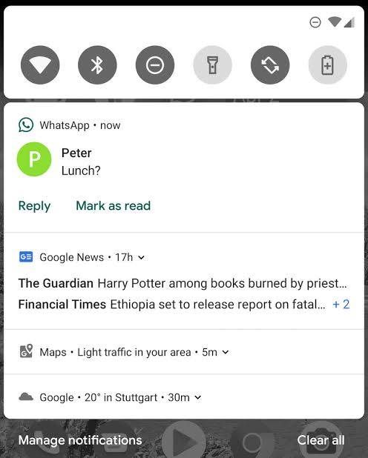
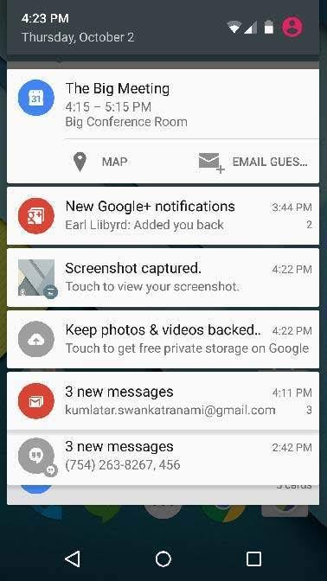
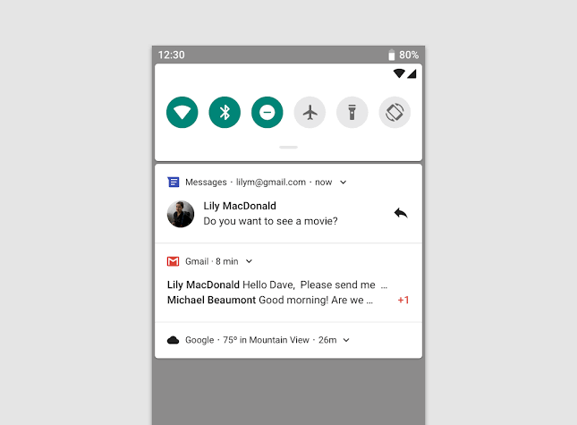
Notification Example

Slide 8
Notification Code?
Java Code
public class MainActivity extends{ private static final String CHANNEL_ID = “My Channel”; private static final int NOTIFICATION_ID = 100; //Drawable drawable = ResourcesCompact.getDrawable(getResources(),R.drawable.new_icon,null); BitmapDrawable bitmapDrawable = (BitmapDrawable) drawable; Bitmap largIcon = bitmapDrawable.getBitmap();// NotificationManager nm = (NotificationManager)getSystemService(NOTIFICATION_SERVICE); Notification notification = new Notification.Builder(this) .setLargeIcon(largIcon) .setSmallIcon(R.drawable.new_icon) .setContextText(“New Message”) .setSubText(“New Message from Naeem Khan”) .setChannelId(CHANNEL_ID) .build();} nm.notify(NOTIFICATION_ID,notification);

Slide 9
Thank You

